Slide 1
Agile Engineering Practices

Slide 2
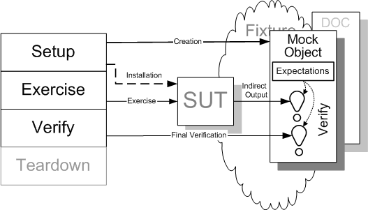
Mocking and Stubbing

Slide 3
When to use it?
Code you are testing depends on remote services
Database
Web services
Behavior you don’t have control on.
E.g. Time and Date.

Slide 4
What you test?
Object interactions
Method called correctly.
Correct parameters are passed.
Verify(customerService, once()).register(anyObject())

Slide 5
What you test?
How your objects work for various responses from other objects
Customer customerWithNoEmail = new Customer(“firstname”, “lastname”);
When(customerService.getCustomer(anyString()).thenReturn(customerWithNoEmail)
emailService.sendEmailTo(customerWithNoEmail);
//expect InvalidArgumentException

Slide 6
Rule
NO ‘new’

Slide 7

Thank You
Copyright 2009 ThoughtWorks, Inc.
www.thoughtworks.com
Notes:
Thank you for joining us for The Origins of Agile Software Development, a module in Agile Fundamentals. The next module in the series is The Agile Core, in which we’ll explore some of the practices and methodologies that make Agile what it is.
Until the next time, we wish you well.

